Slide 1

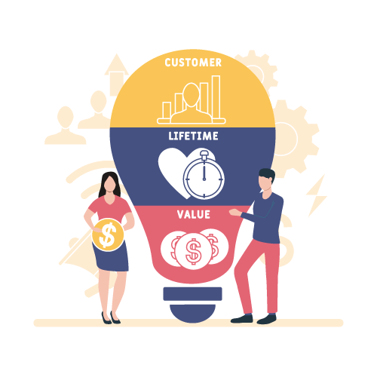
Project 4
DAB 303 Marketing Analytics
Group S2 - 2
Alfred George,
Deepa Taneja Chawla,
Nikulkumar Devataja,
Prathap David Carlo,
Rajesh Gandham

Slide 2

Product Analytics and Customer Lifetime Value (CLV)
What is Product Analytics?
How customers engage and interact with different products?
What is Customer Lifetime Value (CLV)?
Customers' total worth to the business over the course of their lifetime relationship with the company.

Slide 3
Questions to be answered
How to identify the most profitable customers?
How to identify repeat customers?
How to Identify popular and tending products?
How can a company offer the best product and make the most money?
How to segment profitable customers?
How much budget need to spend to acquire customers?
How to improve customer and product retention?

Slide 4

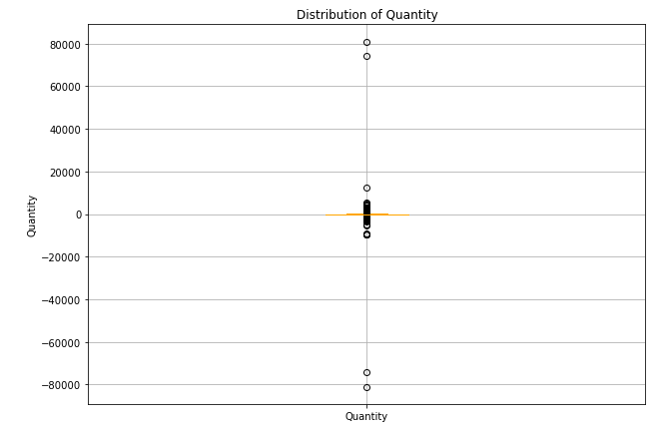
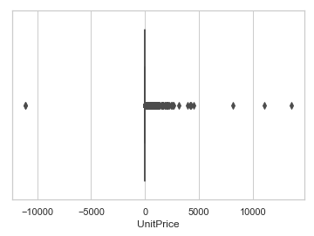
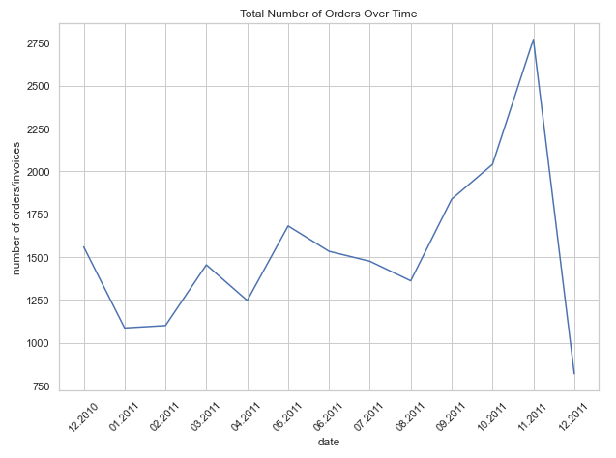
Data Source Review Online Retail.xlsx
Numerical
Quantity
InvoiceDate
UnitPrice
Categorical
InvoiceNo
StockCode
Description
CustomerID
Country
Original Structure: 8 Features & 541,909 Records
Cleaning and Preprocessing
Quantity has negative values : removed 10,624 records (531,285 Records)
Unit Price has negative values : removed 2517 records
Not enough data for the month of Dec ’2011 – Ignored those records
Quantity and Unit Price have outliers, maximum too high, ignoring outliers

Slide 5
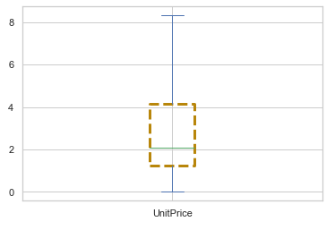
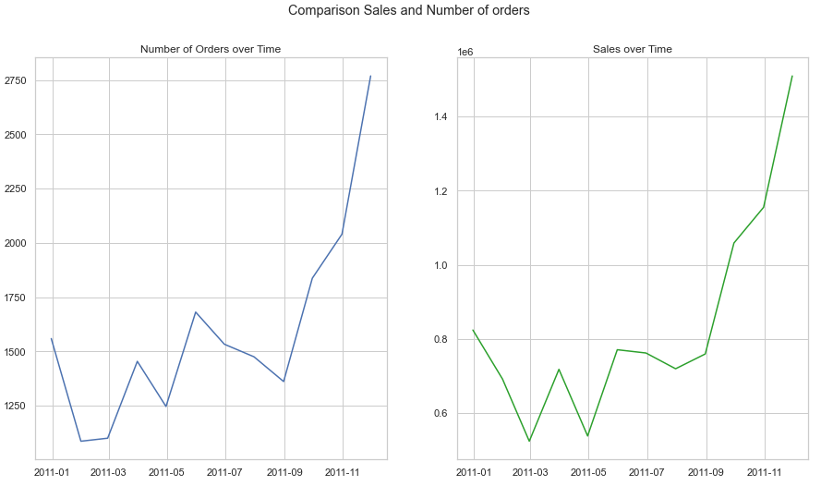
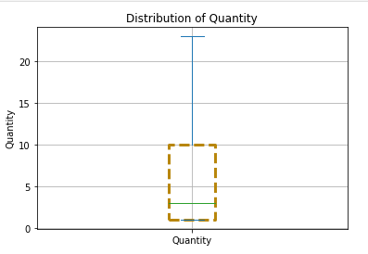
Initial hindsight's
Distribution of Price
Comparison of Number of Orders and Sales over time
Number of Orders
Sales in $ expressed as Exponential numbers 1e6
Similar pattern can be seen for revenue and orders. Revenue is directly proportional to the number of orders. Highest peak in November 2011
Distribution of Quantity and Price without outliers

Slide 6
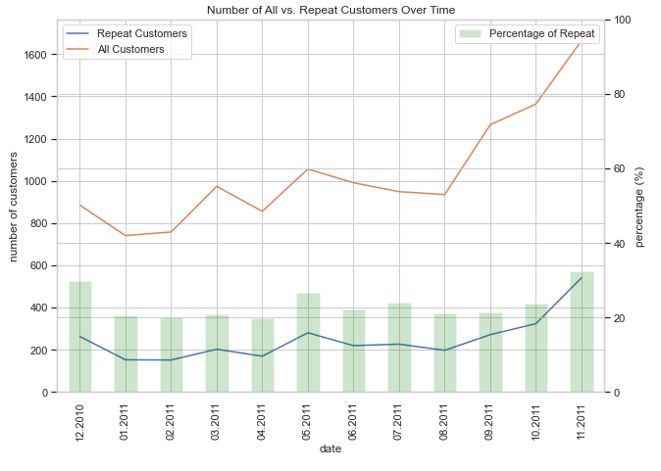
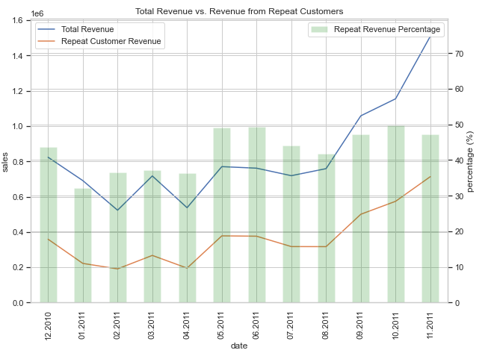
Initial hindsight's
We have steady 20% repeat customers throughout the year. Total customers and repeat customers is higher towards end of year.
Steady 30% revenue due to repeat customers throughout the year. Around May and end of the year it goes to nearly 50%.

Slide 7
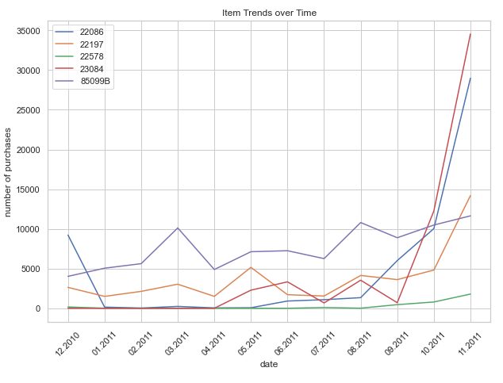
Insights
Top 5 selling products
(based on Quantity)
Spike for the last quarter of the year.
22578 not selling .
23084 did the best.
22086 follows the similar trend as that of 23084
22197, 85099B spikes at different times of the year. They both also see the increase in November.

Slide 8
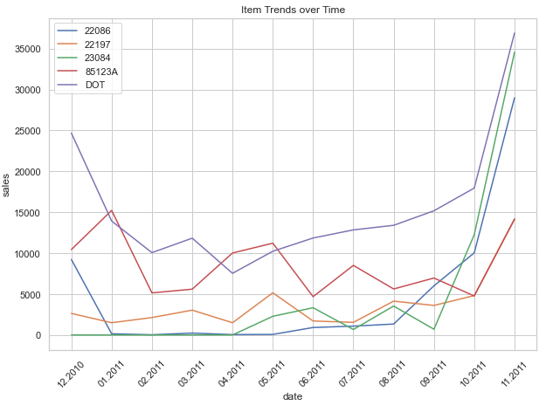
Insights
Top 5 selling products
(based on Sales)
Spike for the last quarter of the year.
DOT is the best product
22197 is the product with lowest sales.
23084 and 22086 has nearly 0 sales till April then increased rapidly making it the second & third largest selling product respectively
85123A has peaks and lows throughout the year
.

Slide 9
Recommended Studies We need to look at further data and answer these questions to make a marketing strategy
What led in the sudden increase in the purchases?
What type of product are these ?
Is that an organic purchase?
Is it an outcome of a campaign?
Why users increased interest on the product?
What relates to spikes in March, May and August?

Slide 10
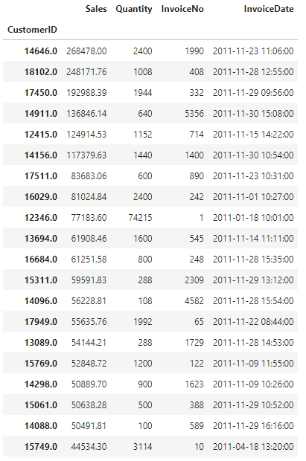
Further Exploration
F R
We have 17754 orders over the year
We have nearly 4297 Customers
We have 3919 products
Our top 20 customers based on sales value through out the year, they are buying frequently, recently except two customers

Slide 11
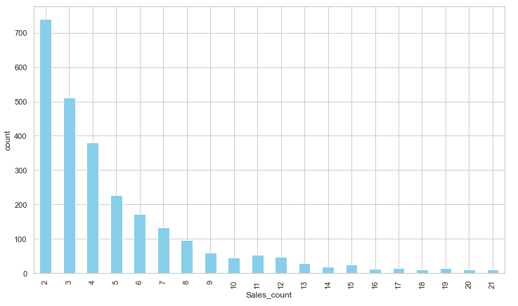
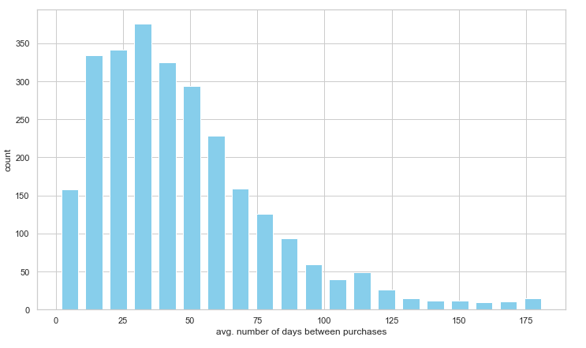
Number of purchases are maximum from 2-7 We can work closely with customers who are buying more than 4 times, to become our loyal customers, we can introduce new products to them too.
Insights
Number of purchases made by customers Average Days between purchases for repeat customers
Most of the customers are buying frequently. Some have not bought for more than 6 months. Send marketing communication to them and remind them, introduce new products and them discount coupons for the products they bought earlier.

Slide 12
Recommendations
1. Sales usually peak during the month of November and December, however its only some of the products that are high in demand during the end of the year, focus on marketing, stocking those items.
2. Repeat customers consist of the 20% of the customers however they contribute around 30 to 47% of the total revenue that means the
Increase sales through existing customers
Work to identify losing/dormant customers and try to retain them.
There are some very high value customers who seem to not have returned, we need to engage them
Carry out RFM analysis on customers and plan specific campaigns
Acquire some new customers
3. Sales are up at the end of the year, run selective campaign to concentrate on high selling products, increase profit margin, promote sales for products that don’t show any sales throughout the year if they are not seasonal product.

Slide 13
Recommendations
4. According to Pareto’s principle: 80% of business should be coming from 20% customers. Schedule loyalty schemes such as the discount, offers, coupons, bonus point, and gifts for them.
5. Product repositioning for some products, make use of targeted audience campaigns and different marketing strategies to fill in the gap.
6. Retain customers with high CLV Value and based on impact matrix work on customers with low CLV.
7. Calculate the average CLV and that will give how much can we comfortably spend on marketing and sales for customer acquisition.
8. It will also tell us how much should we spend on customer service to retain an existing customer.
9. Combine this with demographics to find most valuable customers and better target this demographic for future sales

